Slide 1
Procedure VS Object oriented programming
Google Class room code: oraeio

Slide 2
Procedure Oriented Programming
It means “a set of procedures” which is a “set of subroutines” or a “set of functions“.
functions are called repeatedly in a program to execute tasks performed by them.

Slide 3
#include<stdio.h>
int a,b,c;
void reading(void);
int addition(int, int);
void print(int);
void main()
{
reading();
c=addition(a,b);
print(c);
}
void reading(void)
{
scanf("%d %d",&a,&b);
}
int addition(int a, int b)
{
return a+b;
}
void print(int c)
{
printf("%d",c);
}

Slide 4
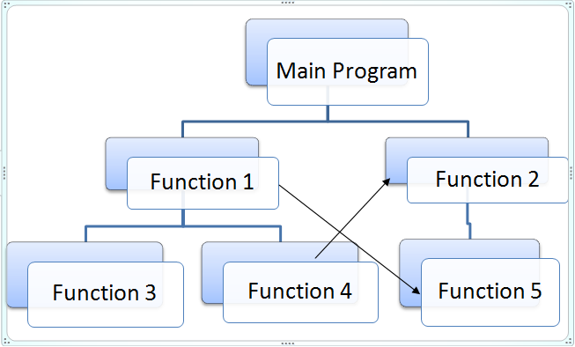

Slide 5
A Real-World Example
Let's say that you are working for a vehicle parts manufacturer that needs to update it's online inventory system. Your boss tells you to program two similar but separate forms for a website, one form that processes information about cars and one that does the same for trucks.
For cars, we will need to record the following information:
Color, Engine Size, Transmission Type, Number of doors
For trucks, the information will be similar, but slightly different. We need:
Color, Engine Size, Transmission Type, Cab Size, Towing Capacity

Slide 6
Scenario 1
Suppose that we suddenly need to add a bus form, that records the following information:
Color, Engine Size, Transmission Type
Number of passengers
Procedural: We need to recreate the entire form, repeating the code for Color, Engine Size, and Transmission Type.
OOP: We simply extend the vehicle class with a bus class and add the method,numberOfPassengers.

Slide 7
Scenario 2
Instead of storing color in a database like we previously did, for some strange reason our client wants the color emailed to him.
Procedural: We change three different forms: cars, trucks, and buses to email the color to the client rather than storing it in the database.
OOP: We change the color method in the vehicle class and because the car, truck, and bus classes all extend (or inherit from, to put it another way) the vehicle class, they are automatically updated.

Slide 8
Scenario 3
We want to move from a generic car to specific makes, for example: Nissan and Mazda.
Procedural: We create a new form for each make, repeating all of the code for generic car information and adding the code specific to each make.
OOP: We extend the car class with a Nissan class and a Mazda class and add methods for each set of unique information for that car make.

Slide 9
Scenario 4
We found a bug in the transmission type area of our form and need to fix it.
Procedural: We open and update each form.
OOP: We fix the transmission Type method in the vehicle class and the change perpetuates in every class that inherits from it.

Slide 10
Procedural vs. Object-Oriented Programming
POP | OOP
In POP, program is divided into small parts called functions. | In OOP, program is divided into parts called objects.
POP does not have any proper way for hiding data so it is less secure. | OOP provides Data Hiding so provides more security.
Example of POP are : C, VB, FORTRAN, Pascal. | Example of OOP are : C++, JAVA, VB.NET, C#.NET.

Slide 11
Procedural vs. Object-Oriented Programming
Procedural:
Object-Oriented:
Top down design
Object focused design
Limited code reuse
Code reuse
VS.
Complex code
Complex design
Global data focused
Protected data

Slide 12
Object Oriented Methodology is a certain process through which software can be developed. The goals of this methodology are to achieve Software Systems that are reliable, reusable, extensible; hence, more useful in the long run. The methodology achieves its goals by the help of a collection of objects that communicate by exchanging messages.

